Slide 1


Continuous Deployment

Slide 2



Course : Mastering DevOps
Lecture On : Continuous Deployment
Instructor: Dipesh Garg

Slide 3
Prerequisites for this session
Basic understanding of Jenkins and continuous integration
Basic understanding of Amazon ECS and EC2

Slide 4
Semantic Versioning and
Continuous Delivery

Slide 5
Semantic Versioning and Continuous Delivery
While following continuous delivery and continuous deployment of software, another important aspect is versioning your releases
You should automatically version your releases with a version scheme before every release of your system through a CI-CD pipeline
Your versioning scheme should convey some meaning to the end consumers so that they can differentiate between two distinct releases
A popular software versioning scheme is semantic versioning
In this scheme, the software version consists of the following:
<MAJOR>.<MINOR>.<PATCH>

Slide 6
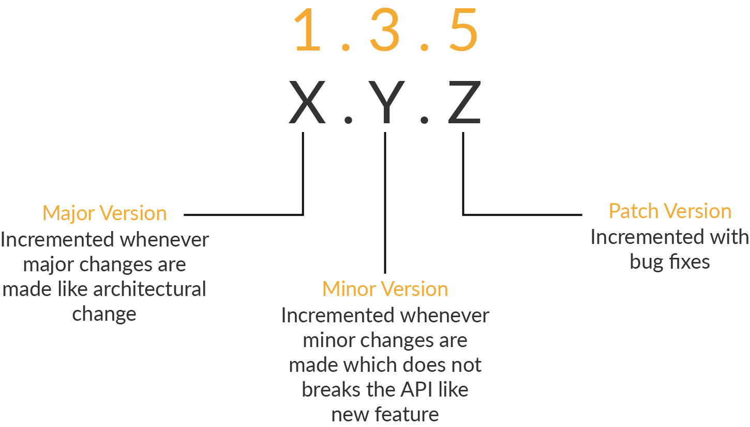
Semantic Versioning and Continuous Delivery

Slide 7
Semantic Versioning and Continuous Delivery
As seen in the image on the previous slide, when you follow semantic versioning in your CI-CD pipeline, you first give an initial version and, then, increase the version numbering as follows:
  MAJOR version - when the release introduces backward incompatible changes (the end user of your API functionality is affected)
  MINOR version - when you add additional functionality in a backward compatible manner
  PATCH version - when you make backward-compatible bug fixes
Usually, you treat your default branch (master, main) in the VCS system for the purpose of releasing the software

Slide 8
Blue Ocean Plugin for Jenkins

Slide 9
Blue Ocean Plugin for Jenkins
Blue Ocean is a plugin for Jenkins, which provides a new UI for Jenkins based on a personalizable modern design that allows users to graphically create, visualize, and diagnose CD Pipelines
Its various features are:
  Provides sophisticated visualizations of CD pipelines
  Creates visually intuitive Pipelines with the help of a Pipeline editor
  Can be personalized to suit the role-based needs of each team member
  Enables native integration for branch and pull requests
For more information, you can visit the official documentation for Blue Ocean here

Slide 10
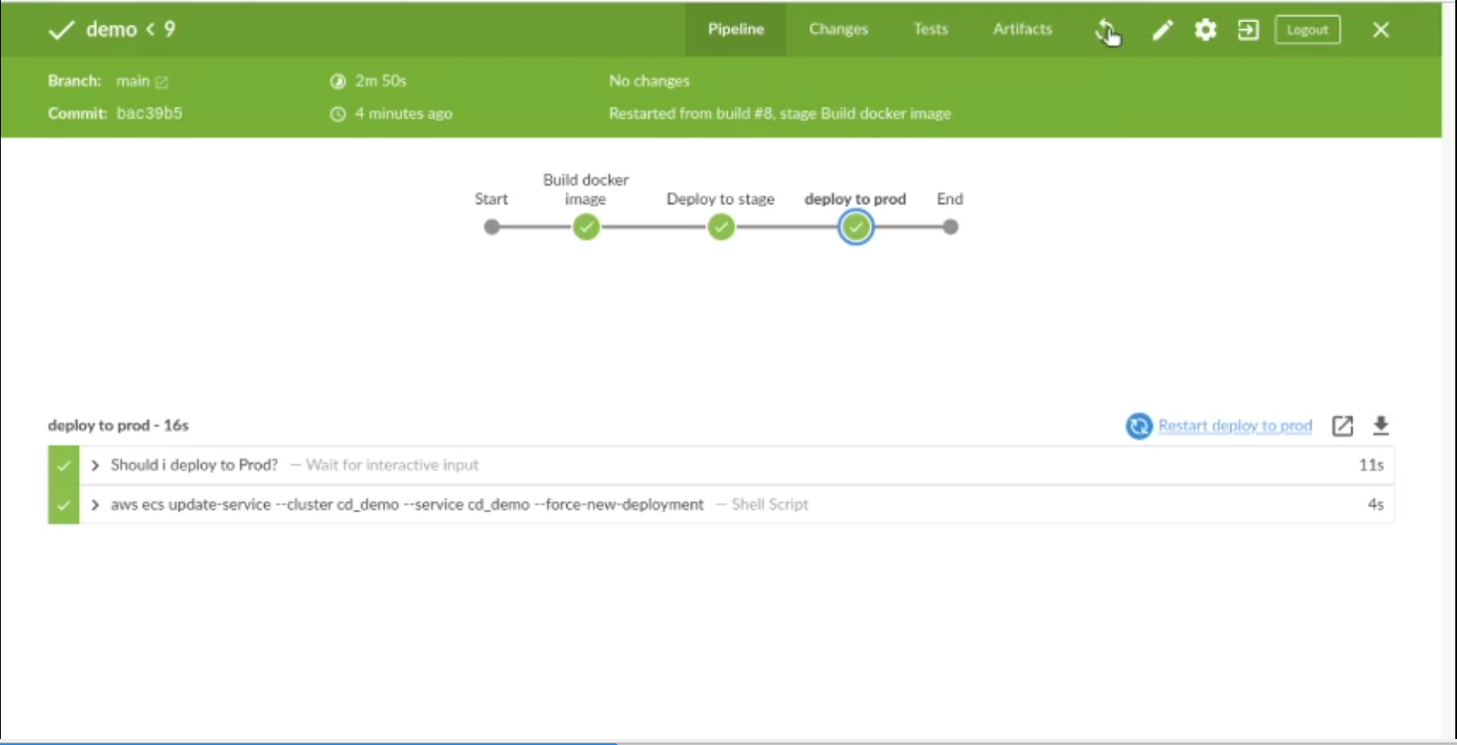
Blue Ocean Plugin for Jenkins

Slide 11
Deployment Strategies

Slide 12
Rolling Deployment
A step-by-step approach
Reduces the risks of downtime
The new version in the deployment gradually replaces the previous one
If we have five servers in which the application is deployed, the new version deployment will occur in one server, followed by the next. This will be repeated for all five
This will ensure that if we have some errors, we find this early and rectify it before the system collapses and avoid downtime for the user
When it comes to containerized applications, a pod/container with the new version pops up. Then, once that is active, the older one is wiped away. So, the user does not experience downtime, and there is a change

Slide 13
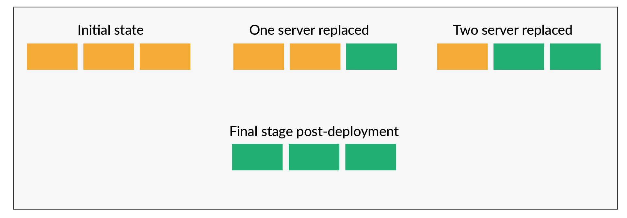
Rolling Deployment

Slide 14
Rolling Deployment
Jenkins: In the pipeline, each stage will have the following:
  Deployment
  Validation of the new version
  Switching the load balancer settings

Slide 15
Blue-Green Deployment
Fail-safe way of deployment
Two identical production environments will be available
One will take all the user traffic as of now: blue
The second one will be idle, which is a clone of the blue one: green
Mostly, the same DB and configurations are used
The new version is deployed to the green environment
The green environment is tested

Slide 16
Blue-Green Deployment
Once the tests are successful, the traffic is routed to the current green environment
Then, the green environment becomes active, and the blue one becomes idle
This process is ideal for immediate rollback when the deployment fails, and new changes need to be tested without the user being interrupted

Slide 17
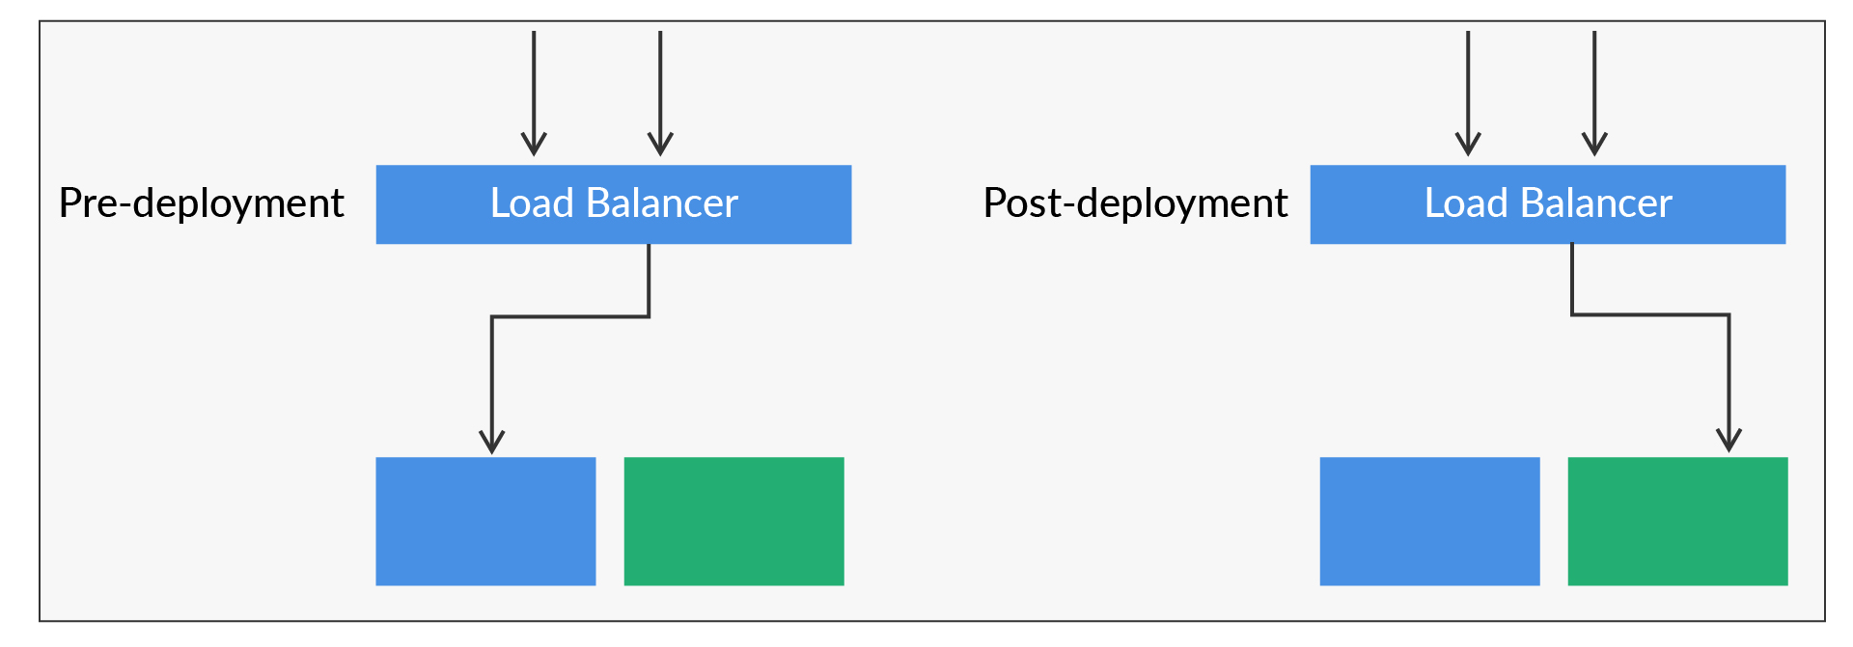
Blue-Green Deployment

Slide 18
Canary Deployment
Similar to Blue-Green Deployment
The phased approach to switching between different versions of an application
The new version is deployed/released to a small part of the infrastructure
The load balancer is modified for some user traffic to be routed to the new version
If no errors are reported, we can roll forward the version to all the remaining infrastructure

Slide 19
Canary Deployment
The deployment can be opened up to the user base in this way:
- Internal users for check
- Regional users
- IP address ranges
- Based on user behavior

Slide 20
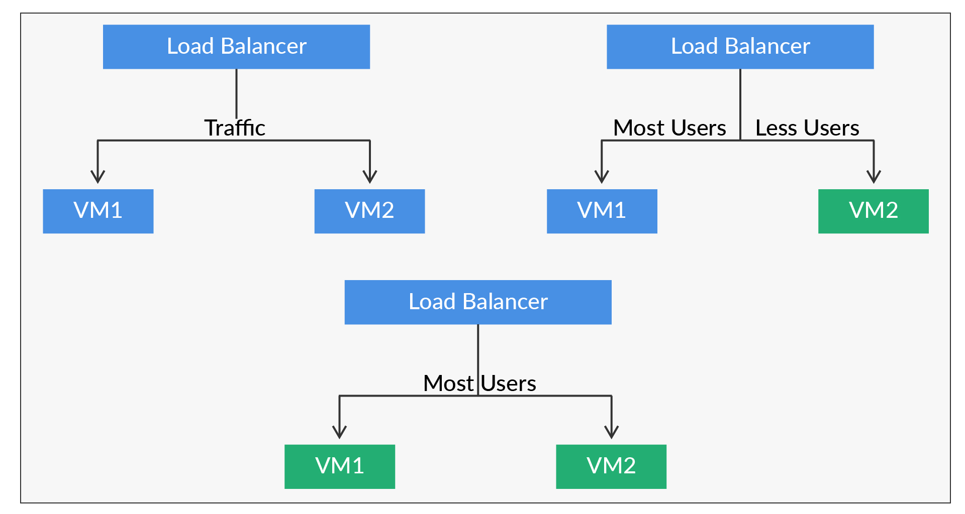
Canary Deployment

Slide 21


Poll (15 seconds)
Which of the following deployment methods will be preferred if you want to release the code first to some beta users in a region?
Blue green
Rolling
Canary
Practice in teams of 4 students
Industry expert mentoring to learn better
Get personalised feedback for improvements
21

Slide 22
Poll (15 seconds)
Which of the following deployment methods will be preferred if you want to release the code first to some beta users in a region?
Blue green
Rolling
Canary
Practice in teams of 4 students
Industry expert mentoring to learn better
Get personalised feedback for improvements
22

Slide 23
Jenkins Third Party Plugins
It is a common practice to integrate third-party API/software into CD pipelines
These are used for various use cases and reasons that include:
  Notifications
  Alerts
  Monitoring
You can look at how you can integrate the APIs of Slack and Teams into the Jenkins pipeline

Slide 24
Jenkins Third Party Plugins
In Jenkins, you can use the plugin “Slack Notification Plugin”
Once the plugin is available, you can take the following steps:
  slackSend: Send a Slack message
  slackUploadFile: Upload a file to Slack

Slide 25
Jenkins Build Metrics

Slide 26
Build Metrics
Build metrics are key in Jenkins when it comes to an organization
The users will get an idea of how the build is working and how the results are
You need to monitor these few important metrics:
  The Build History Metrics Plugin can be used, which can calculate the following:
    Metrics Time to Failure (MTTF)
    Mean Time to Recovery (MTTR)
    Standard deviation of the build times

Slide 27
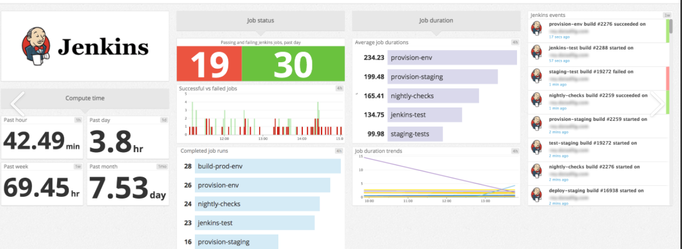
Build Metrics
See the Trends on the Build Metrics Plugin (as shown below)

Slide 28
Job Sequencing in Jenkins

Slide 29
Job Sequencing in Jenkins
In Jenkins, multiple jobs can be clubbed together to be executed in a sequence
It can be achieved through phases in Jenkins build
Each phase will have a Jenkins job, and the project will be a multi-job project
To run N jobs sequentially, add N phases to your MultiJob project, and then, add one job to each phase

Slide 30
Doubt Clearance Window

Slide 31
Tasks to Complete After Today’s Session
MCQs
Conceptual Questions
Project Checkpoint

Slide 32
Thank You!

